Slide 1
Artificial Intelligence

Slide 2
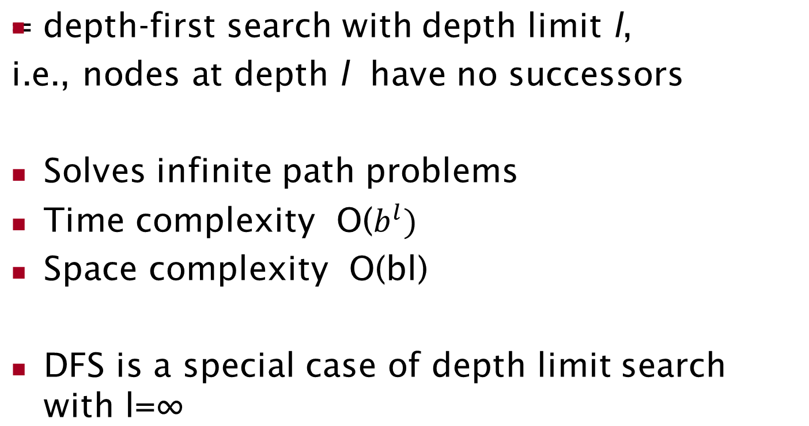
4. Depth-limited search

Slide 3
4. Depth-limited search
Depth limited search can terminate with two kinds of failure:
  The standard failure value indicates no solution
  The cutoff value indicates no solution with the depth limit.

Slide 4
Iterative-Deepening Search (IDS)
IDS is a general strategy often used with depth first search, that finds the best depth limit.
Gradually increases the limit, first 0, then 1, then 2 and so on until a goal is found.
This occurs when the depth limit reaches d, the depth of shallowest goal node.

Slide 5
Iterative-Deepening Search (IDS)
deepeningSearch(problem)
S
start
depth: 1, # of nodes tested: 1, expanded: 1
expnd. node | Frontier
 | {S}
S not goal | {A,B,C}
5
2
4
A
B
C
9
4
6
2
D
E
6
G
goal
1
F
7
H
Notes:
CLICK ONCE

Slide 6
Iterative-Deepening Search (IDS)
deepeningSearch(problem)
S
start
depth: 1, # of nodes tested: 2, expanded: 1
expnd. node | Frontier
 | {S}
S | {A,B,C}
A not goal | {B,C} no expand
5
2
4
A
B
C
9
4
6
2
D
E
6
G
goal
1
F
7
H
Notes:
CLICK ONCE

Slide 7
Iterative-Deepening Search (IDS)
deepeningSearch(problem)
S
start
depth: 1, # of nodes tested: 3, expanded: 1
expnd. node | Frontier
 | {S}
S | {A,B,C}
A | {B,C}
B not goal | {C} no expand
5
2
4
A
B
C
9
4
6
2
D
E
6
G
goal
1
F
7
H
Notes:
CLICK ONCE

Slide 8
Iterative-Deepening Search (IDS)
deepeningSearch(problem)
S
start
depth: 1, # of nodes tested: 4, expanded: 1
expnd. node | Frontier
 | {S}
S | {A,B,C}
A | {B,C}
B | {C}
C not goal | { } no expand-FAIL
5
2
4
A
B
C
9
4
6
2
D
E
6
G
goal
1
F
7
H
Notes:
CLICK ONCE

Slide 9
Iterative-Deepening Search (IDS)
deepeningSearch(problem)
S
start
depth: 2, # of nodes tested: 4, expanded: 2
expnd. node | Frontier
 | {S}
S | {A,B,C}
A | {B,C}
B | {C}
C | { }
S no test | {A,B,C}
5
2
4
A
B
C
9
4
6
2
D
E
6
G
goal
1
F
7
H
Notes:
CLICK ONCE

Slide 10
Iterative-Deepening Search (IDS)
deepeningSearch(problem)
S
start
depth: 2, # of nodes tested: 4, expanded: 3
expnd. node | Frontier
 | {S}
S | {A,B,C}
A | {B,C}
B | {C}
C | { }
S | {A,B,C}
A no test | {D,E,B,C}
5
2
4
A
B
C
9
4
6
2
D
E
6
G
goal
1
F
7
H
Notes:
CLICK ONCE

Slide 11
Iterative-Deepening Search (IDS)
deepeningSearch(problem)
S
start
depth: 2, # of nodes tested: 5, expanded: 3
expnd. node | Frontier
 | {S}
S | {A,B,C}
A | {B,C}
B | {C}
C | { }
S | {A,B,C}
A | {D,E,B,C}
D not goal | {E,B,C} no expand
5
2
4
A
B
C
9
4
6
2
D
E
6
G
goal
1
F
7
H
Notes:
CLICK ONCE

Slide 12
Iterative-Deepening Search (IDS)
deepeningSearch(problem)
S
start
depth: 2, # of nodes tested: 6, expanded: 3
expnd. node | Frontier
 | {S}
S | {A,B,C}
A | {B,C}
B | {C}
C | { }
S | {A,B,C}
A | {D,E,B,C}
D | {E,B,C}
E not goal | {B,C} no expand
5
2
4
A
B
C
9
4
6
2
D
E
6
G
goal
1
F
7
H
Notes:
CLICK ONCE

Slide 13
Iterative-Deepening Search (IDS)
deepeningSearch(problem)
S
start
depth: 2, # of nodes tested: 6, expanded: 4
expnd. node | Frontier
 | {S}
S | {A,B,C}
A | {B,C}
B | {C}
C | { }
S | {A,B,C}
A | {D,E,B,C}
D | {E,B,C}
E | {B,C}
B no test | {G,C}
5
2
4
A
B
C
9
4
6
2
D
E
6
G
goal
1
F
7
H
Notes:
CLICK ONCE

Slide 14
Iterative-Deepening Search (IDS)
deepeningSearch(problem)
S
start
depth: 2, # of nodes tested: 7, expanded: 4
expnd. node | Frontier
 | {S}
S | {A,B,C}
A | {B,C}
B | {C}
C | { }
S | {A,B,C}
A | {D,E,B,C}
D | {E,B,C}
E | {B,C}
B | {G,C}
G goal | {C} no expand
5
2
4
A
B
C
9
4
6
2
D
E
6
G
goal
1
F
7
H
Notes:
CLICK ONCE

Slide 15
Iterative-Deepening Search (IDS)
deepeningSearch(problem)
S
start
depth: 2, # of nodes tested: 7, expanded: 4
expnd. node | Frontier
 | {S}
S | {A,B,C}
A | {B,C}
B | {C}
C | { }
S | {A,B,C}
A | {D,E,B,C}
D | {E,B,C}
E | {B,C}
B | {G,C}
G | {C}
5
2
4
A
B
C
9
4
6
2
D
E
6
G
goal
1
F
7
H
path: S,B,G
cost: 8
Notes:
CLICK ONCE

Slide 16
Properties of iterative deepening search
Complete? Yes
Time? (d+1)b⁰ + d b¹ + (d-1)b² + … + b^{d} = O(b^{d})
Space? O(bd)
Optimal? Yes, if step cost = 1

Slide 17
5. Bidirectional search
Run two simultaneous searches
  One forwards, from the initial state
  Other backward from the goal.
Stops when the two states meet in the middle
BFS is applied at both sides of searches

Slide 18
Bidirectional search
S
Forward
A
D
Backwards
B
D
A
E
C
E
E
B
B
F
11
D
F
B
F
C
E
A
C
G
14
17
15
15
13
G
C
G
F
19
19
17
G
25

Slide 19
Bidirectional Search
Complete: Yes, if b is finite
Optimal: Not
Time & Space complexity: O(b^{d/2})
Complete in Breadth for search but not in DFS.

Slide 20
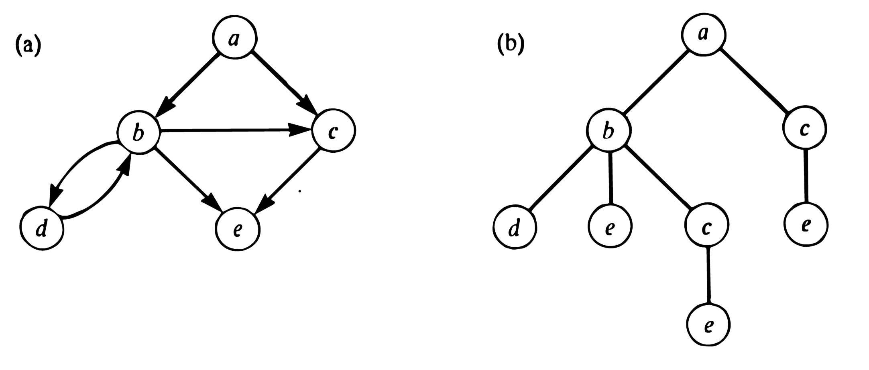
Searching graphs
Do our techniques work on graphs, not just trees?
Graph unfolds into a tree, parts of graph may repeat many times
Techniques work, but may become very inefficient
Better: add check for repeated nodes

